Slide 1
Android Application Permission Manager
Protecting users from malicious apps
Katherine Schwartz

Slide 2
Concepts
Android permissions allow an app access to information and systems on the phone, with the user’s consent.
Some permissions are dangerous, allowing an app to access personal information about the user
Malware and advertisements included in apps can take advantage of permissions to gain access to phone systems and the user’s information.

Slide 3
Previous Work
The method used to determine which apps are dangerous has been determined. The aspects focus on include:
Permissions not required for app functions
Dangerous combinations of permissions
Range of app permissions used by each app category
Possible privacy threats each app can expose users to
Ad networks associated with apps in Google Play
The basic AAPM Framework is nearly complete
Main functionality already implemented
Final features will be completed shortly

Slide 4
Work Required
Finalize AAPM framework
Testing and tweaking of AAPM
Find apps on which to test framework
Test framework on known apps to make sure it functions correctly
Write journal paper for publication in IEEE Transactions

Slide 5
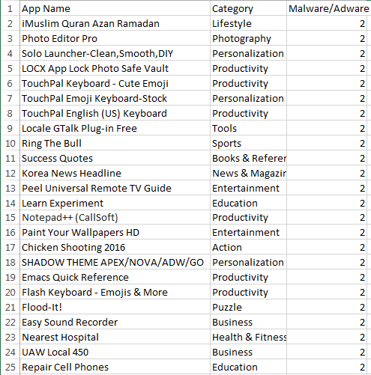
Current Work
Creation of a list of Google Play apps
associated with adware or malware
The master list currently contains 178 entries,
while my personal list contains 58 entries

Slide 6
What’s Next
Identification of app networks utilized on the adware-associated apps
Testing of the AAPM Framework on the apps we have identified

Slide 7
References
N. Okazaki, Y. Kita, K. Aburada and M. Park, "Security Evaluation System for Android Applications Using User's Reviews and Permissions", Journal of Robotics, Networking and Artificial Life, vol. 2, no. 3, p. 190, 2015.
P. Faruki et al., "Android Security: A Survey of Issues, Malware Penetration, and Defenses," in IEEE Communications Surveys & Tutorials, vol. 17, no. 2, pp. 998-1022, Secondquarter 2015.
M. La Polla, F. Martinelli and D. Sgandurra, "A Survey on Security for Mobile Devices," in IEEE Communications Surveys & Tutorials, vol. 15, no. 1, pp. 446-471, First Quarter 2013.

