Slide 1
Android Application Permission Manager
Week 5 update
Katherine Schwartz
Eralda Caushaj

Slide 2
This Week’s Progress: Overview
Researched options for a new classification scheme using machine learning
Got a feel for various models using Orange
Converted data into an appropriate format to use as input
Assigned arbitrary labels to a small subset of the data to allow for preliminary testing
Gained a deep understanding of the math behind the models

Slide 3
Classification, Version 2.0
RIP algorithm 2016-2016, we’re moving into the modern age- machine learning
Same five factors, but with an adaptable learning approach
Unsupervised?
  No labelling required
  Groups data into similar clusters or detects anomalies, not helpful when we already know our classes
Supervised?
  Requires labelling of training data (yikes!)
  However, it’s much better suited to the distribution of our data

Slide 4
Orange Data Mining software
Free, open-source
Easy to learn
Includes many machine learning models
Allows for excel spreadsheets to be used as data

Slide 5
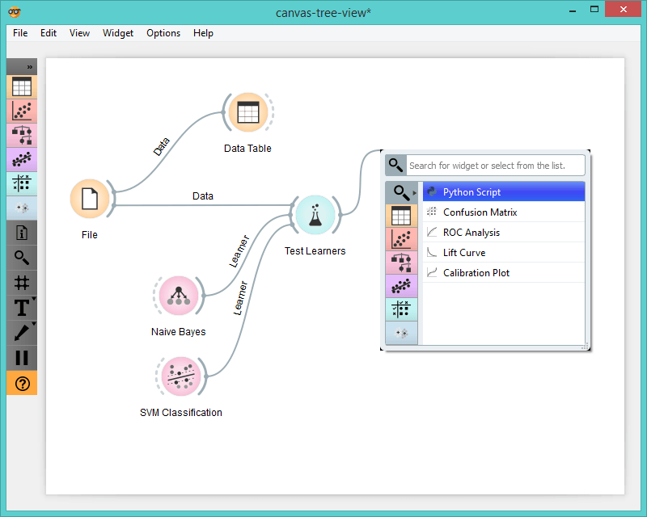
Better living through Orange
Powerful data mining software with many machine learning options. It’s drag-and-drop, so learning and using it is simple.

Slide 6
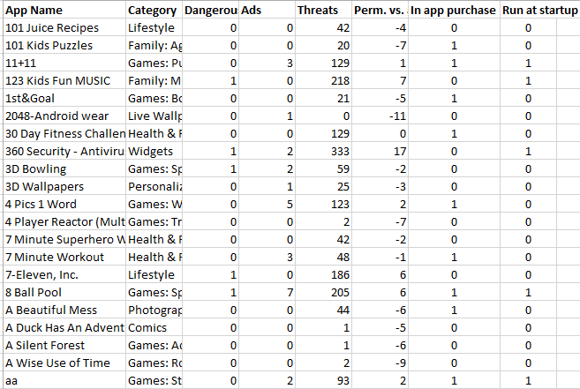
Formatting thousands of data entries
We had an abundance of data, spread over a half-dozen spreadsheets. We needed a single input file.

Slide 7
Initial testing
Required arbitrary labels, but allowed us to get a look at how various models dealt with our data.
Process:
  Manually labelled 50 “obvious” cases of each or three different categories: safe-benign-dangerous
  Used these cases as a (very small!) training set for various models
  Adjusted scaling, compared models, observed patterns

Slide 8
The Math behind the models
What really goes on in those “black boxes”?
Dove deep and wrote step-by-step summary papers to deepen our understanding
Important factors to consider for our data:
  How does the model handle multiclass classification?
  How does it handle binary features? Non-binary features? A mixture?

Slide 9
The models
Naive Bayes
  Probabilistic classifier that assumes independence between features
  Handles multiclass problems with ease
K-nearest-neighbor
  Determines class of a new item based on classes of known data closest to it
  Simple, easy to understand. Perhaps too simple for such a complex problem.
Support Vector Machine
  Determines an optimal separator between classes
  Natively a binary system, various methods must be used to make it work with three classes
Classification Tree
  Creates a tree with various decision nodes based on features
  Easy to understand what’s going on, but overfitting can be an issue

Slide 10
What’s next
Label our data “for real”- at least enough for a strong training set
Use labelled data to determine the model most suited for our project
Implement the chosen machine learning model in our framework

Slide 11
References:
"Orange Data Mining", University of Ljubljana Bioinformatics Laboratory. [Online]. Available: http://orange.biolab.si/. [Accessed: 17- Jun- 2016].
H. Peng, C. Gates, B. Sarma, N. Li, Y. Qi, R. Potharaju, C. Nita-Rotaru, and I. Molloy. “Using probabilistic generative models for ranking risks of Android apps”. In Proceedings of the 2012 ACM conference on Computer and communications security, 2012.
S. Sayad, "Decision Tree", Saedsayad.com. [Online]. Available: http://www.saedsayad.com/decision_tree.htm. [Accessed: 17- Jun- 2016].
"1.6. Nearest Neighbors — scikit-learn 0.17.1 documentation", Scikit-learn. [Online]. Available: http://scikit-learn.org/stable/modules/neighbors.html. [Accessed: 17- Jun- 2016].
M. Halls-Moore, "Support Vector Machines: A Guide for Beginners", QuantStart, 2014. [Online]. Available: https://www.quantstart.com/articles/Support-Vector-Machines-A-Guide-for-Beginners. [Accessed: 17- Jun- 2016].

