Slide 1
Android Application Permission Manager: Informing, Empowering, and Protecting Users
Katherine Schwartz
Eralda Caushaj

Slide 2
Outline
Problem introduction
Previous work
Goals
AAPM overview
GUI & Features
Classification
Progress
Conclusion

Slide 3
The Problem:
Android users cannot easily distinguish between safe, risky, and malicious applications.
Risk posed by permissions often unclear
Not informed about advertisers who may collect user data
The Google Play store is not as safe as it appears

Slide 4
Previous Work
Kirin (Enck et al.), Peng et al.’s probabilistic generative models, and Sarma et al.’s benefit adjusted risk signals determine whether an app is malicious by examining permissions
Kurniawan et al. use machine learning classification that takes into account network activity and battery status to identify malicious apps
DroidRanger (Zhou et al.) uses static and dynamic analysis on large datasets
AppIntent (Yang et al.) is a tool to assist experts in locating the origins of data transmission
Securacy (Ferreira et al.) is user-driven and relies on ratings

Slide 5
Previous Work
Take very few factors into consideration
Some require intervention of users/experts
Designed to detect only malware, not threats to privacy

Slide 6
Goals
Take into account multiple features that affect user security and privacy
Evaluate without user intervention
Detect not only malicious apps, but also privacy risks
Provide an easy-to-understand user interface suitable for average users, not just security experts
Assist users in taking smart steps to improve their security

Slide 7
Framework Overview

Slide 8
Features
Allow users to check security of installed apps with easy-to-use GUI
Display list of permissions required by app with explanations
Allow users to revoke dangerous permissions (Android 6.0 and above)

Slide 9
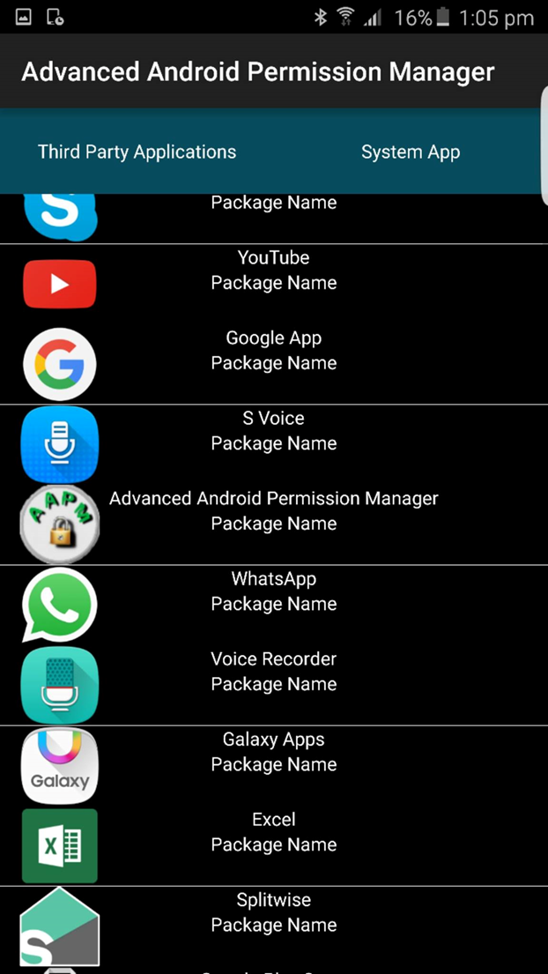
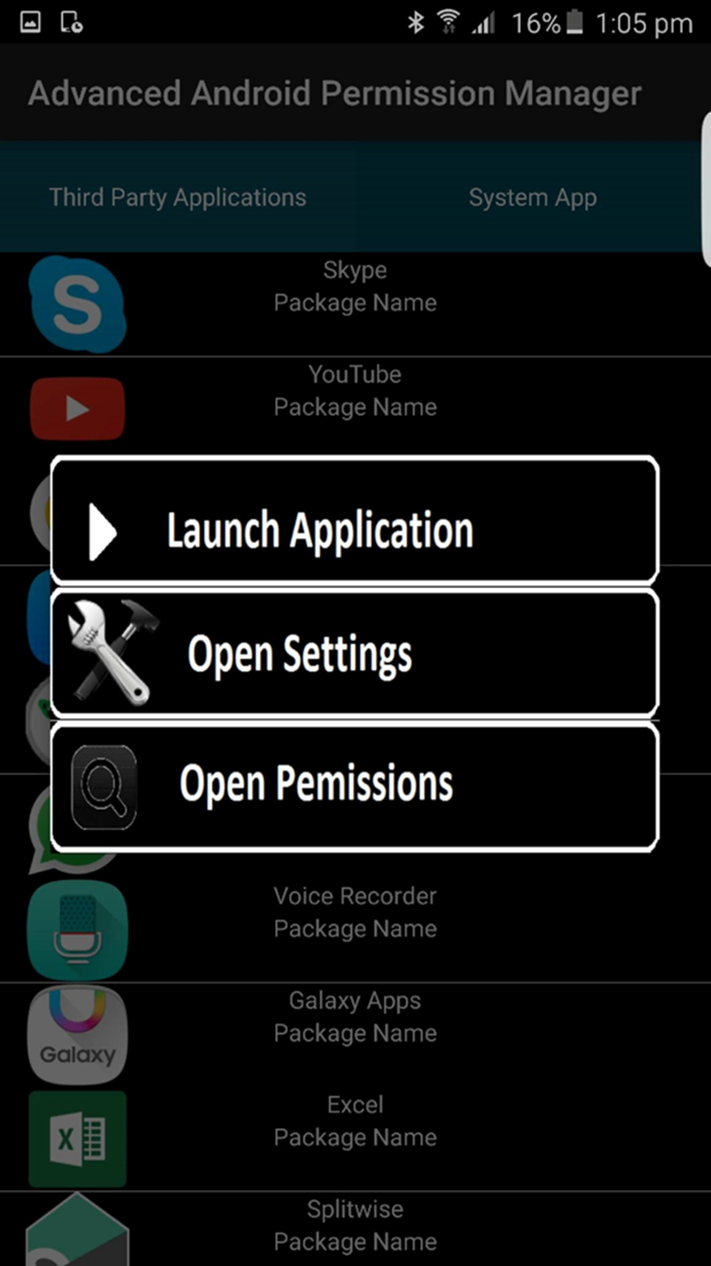
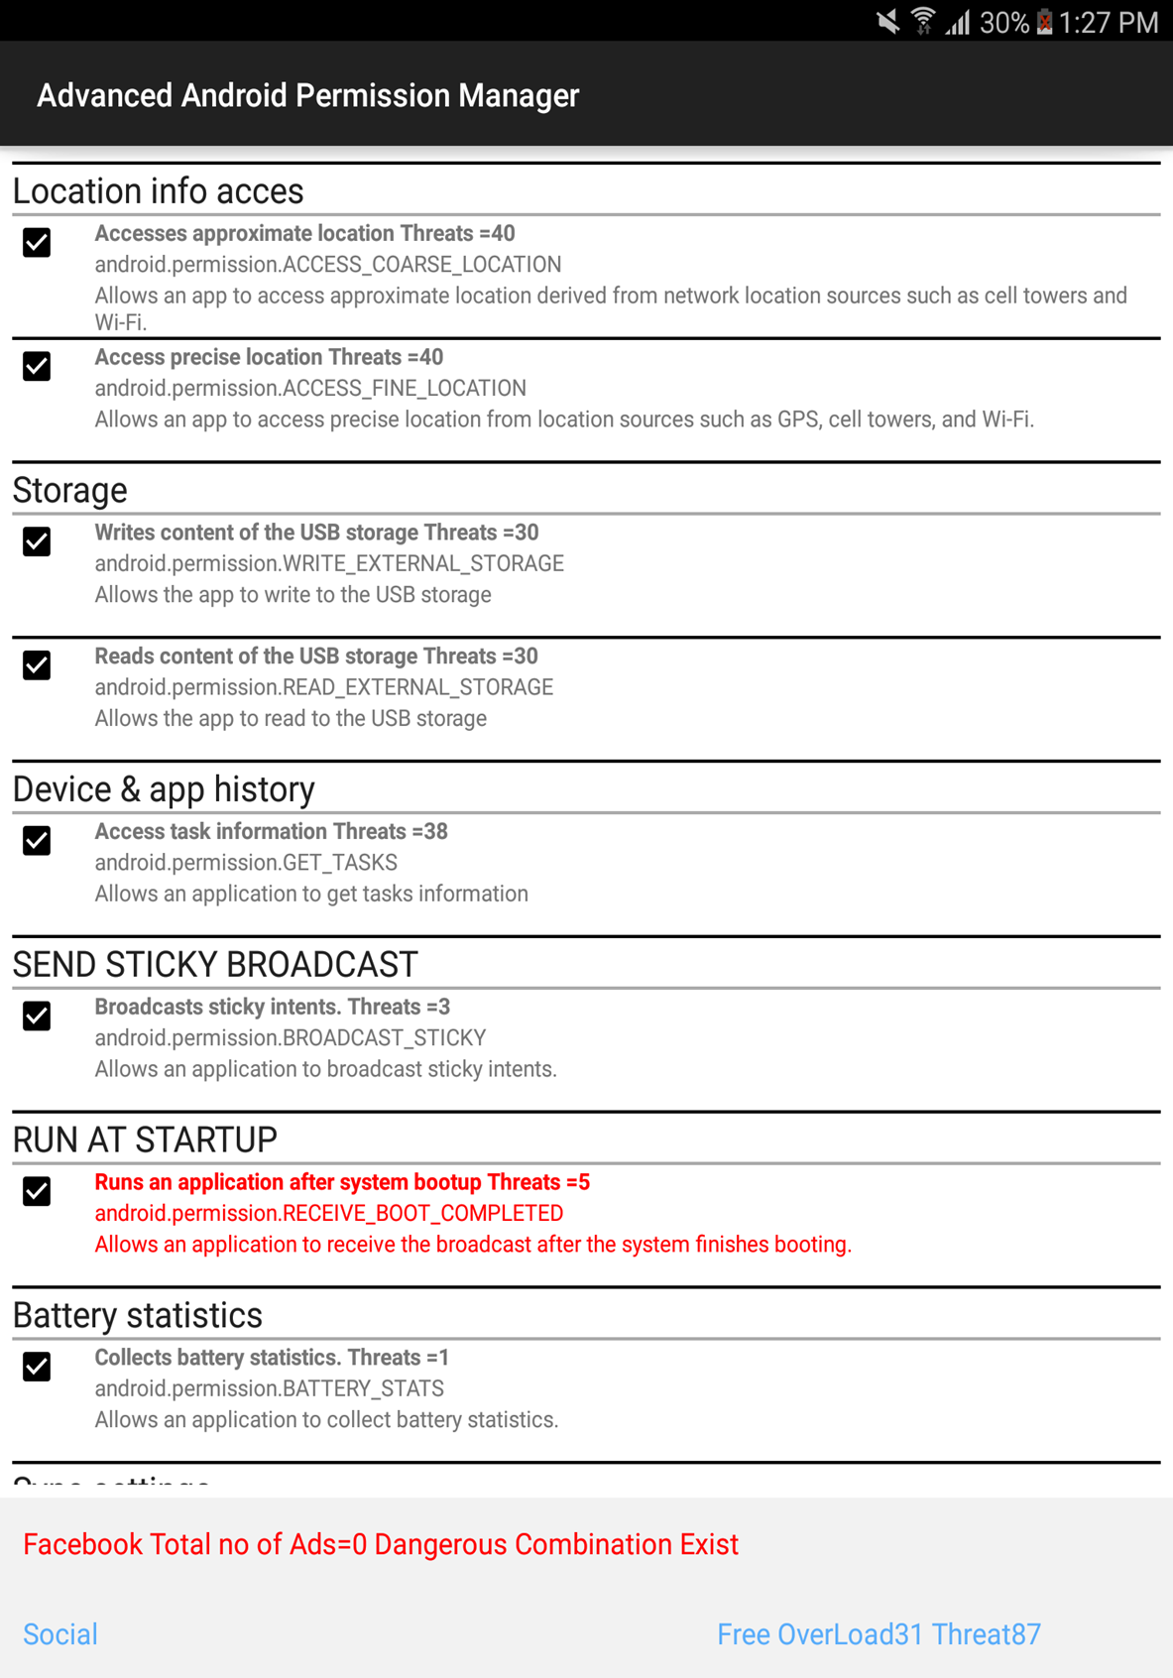
GUI
Open permissions
View information
Select app

Slide 10
Classification Factors
We had to determine a set of factors to base classification on.
Dangerous combinations of permissions
Determined by examining the permissions of 20 high-risk apps
Number of associated ad networks
Total number of unique threats posed by the permissions
Determined by comparing the app’s permissions to the permissions of known malware
Number of permissions vs. the category average
Requests for unnecessary permissions
Run at startup
In-app purchase

Slide 11
Classification Method
We will use supervised machine learning classification, though final choice about which method has not been made
Needed features:
Multiclass classification
Ability to handle binary and non-binary inputs
Possible choices
Naive Bayes
Classification Tree
Random Forest
Support Vector Machine
K-nearest neighbor

Slide 12
Progress: the Research
In-depth study of papers relating to our topic
Malicious app detection
Privacy risk posed by advertisement networks
Machine learning as applied to malware detection
In malicious app detection research, special note was taken of:
Specific goals (malware detection, privacy protection, etc.)
Factors taken into account
Effectiveness

Slide 13
Progress: the App
App GUI nearly complete
Can extract information from other apps
Display permissions
Highlight unnecessary permissions
Calculate unique threats

Slide 14
Progress: the Data
Data on over 1700 Android apps has been collected
Permissions
Number of advertisement networks
Average number of permissions per category
Data combined on one large table to serve as input
Threats and permissions vs. average calculated

Slide 15
Data Table

Slide 16
Progress: the Classification
Started with set algorithm, moved to machine learning classifier
Flexibility
Remove arbitrary thresholds and weights
Testing with Orange Data Mining, an open-source software
Early results with small data sets look promising with various classifiers

Slide 17
Progress: the Paper
Work has begun on sections that do not require specific information on our classification
Abstract
Framework
Related Works

Slide 18
What’s Next
Data
Finish filling in what remains of table (almost complete)
Label data for testing
Classification
Rigorous testing of various classifiers using labelled data
Choose a classifier that suits our data
Implementing classifier into our framework

Slide 19
Conclusion
Privacy-invasive or outright malicious software is a threat to the security of Android users
Our project aims to empower users to make responsible choices about their applications
Machine learning allows for flexible and powerful classification to inform users at a glance
Taking many factors into account allows for a more comprehensive analysis

Slide 20
References
W. Enck, M. Ongtang, and P. McDaniel. “On lightweight mobile phone application certification,” in Proceedings of the 16th ACM conference on Computer and communications security, pp. 235–245, 2009.
H. Peng, C. Gates, B. Sarma, N. Li, Y. Qi, R. Potharaju, C. Nita-Rotaru, and I. Molloy. Using probabilistic generative models for ranking risks of Android apps. In Proceedings of the 2012 ACM conference on Computer and communications security, 2012.
B. Pratim Sarma, N. Li, C. Gates, R. Potharaju, C. Nita-Rotaru and I. Molloy, "Android permissions: a perspective combining risks and benefits", SACMAT '12 Proceedings of the 17th ACM symposium on Access Control Models and Technologies, pp. 13-22, 2012.
Kurniawan, Harry, Yusep Rosmansyah, and Budiman Dabarsyah. "Android Anomaly Detection System Using Machine Learning Classification". 2015 International Conf. Electrical Engineering And Infomatics (ICEEI). Bali: IEEE, 2015. 288-293. Print.
Y. Zhou, Z. Wang, W. Zhou, and X. Jiang. Hey, You, Get off of My Market: Detecting Malicious Apps in Official and Alternative Android Markets. NDSS, 2012.
Z. Yang, M. Yang, Y. Zhang, G. Gu, P. Ning and X. Wang, "AppIntent: analyzing sensitive data transmission in android for privacy leakage detection", in Proc. 2013 ACM SIGSAC conf. on Computer & communications security, 2013, pp. 1043-1054.
D. Ferreira, V. Kostakos, A. Beresford, J. Lindqvist and A. Dey, "Securacy: an empirical investigation of Android applications' network usage, privacy and security", in Proc. 8th ACM Conf. on Security & Privacy in Wireless and Mobile Networks, 2015.
Demsar J, Curk T, Erjavec A, Gorup C, Hocevar T, Milutinovic M, Mozina M, Polajnar M, Toplak M, Staric A, Stajdohar M, Umek L, Zagar L, Zbontar J, Zitnik M, Zupan B (2013) ”Orange: Data Mining Toolbox in Python”. Journal of Machine Learning Research 14(Aug):2349−2353.

